Slide 1


<NAME OF THE PROJECT>
YA Football Quiz
IBRAHIM HASSAN
Amazouz Younes
Python Junior Level 1
2023 – 2024
Notes:
1. INTRODUCTION

Slide 2

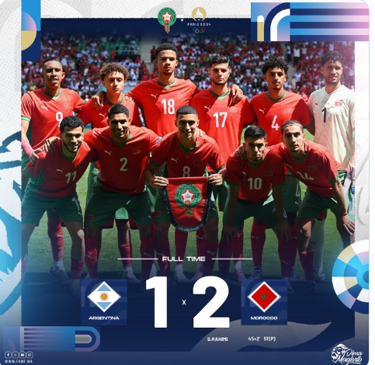
What inspired me to do this project ?
My source of inspiration was the event of Olympic Games and the victory of Morocco against Argentina the 26 July of this year in the group stage
(2 – 1)

Slide 3


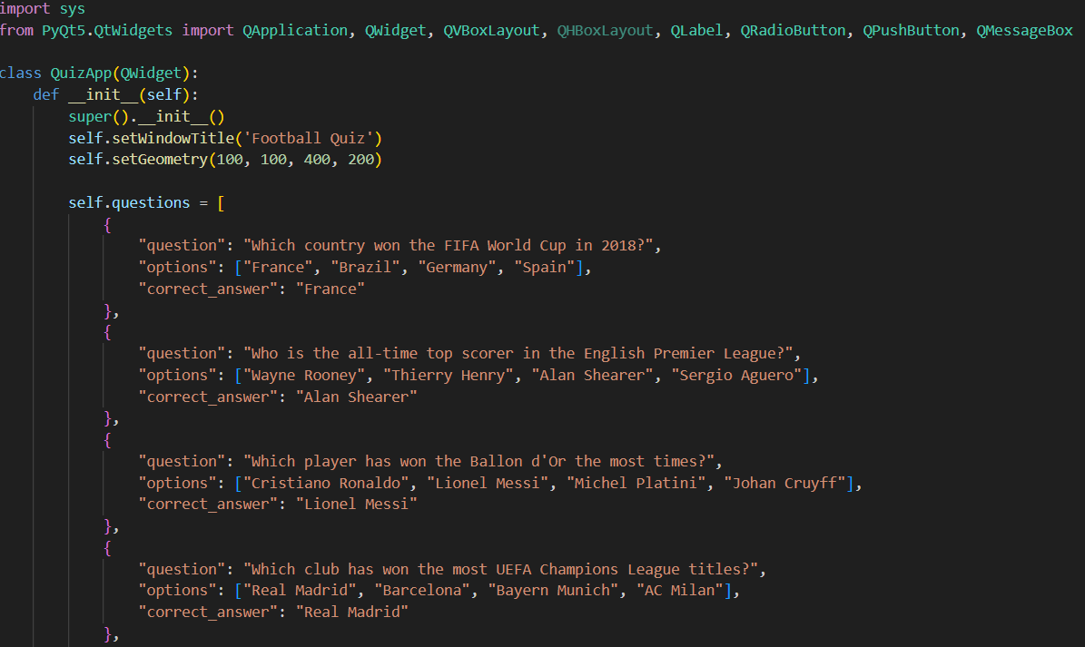
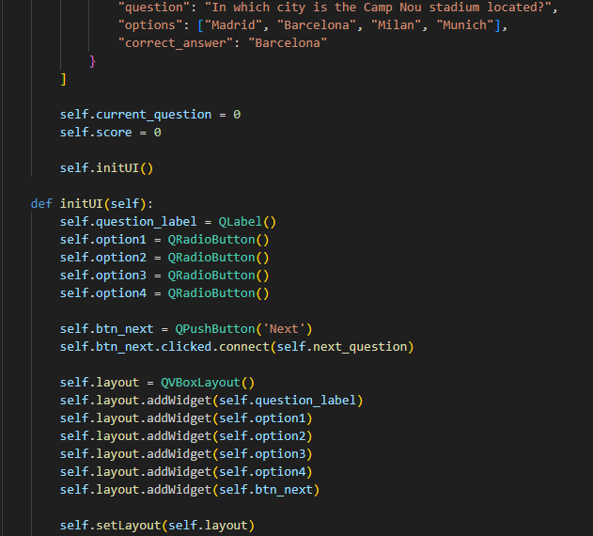
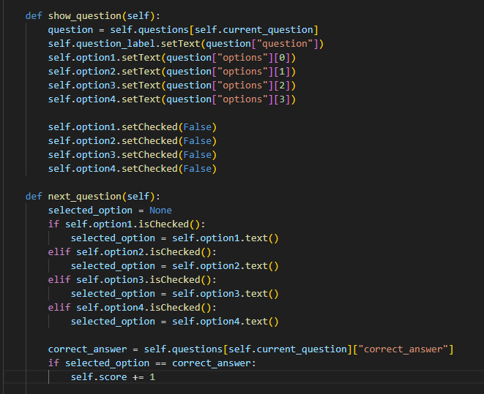
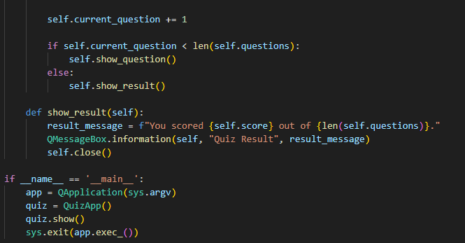
<NAME OF THE PROJECT>
IBRAHIM HASSAN

Slide 4
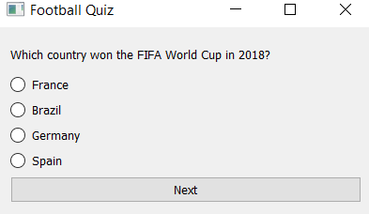
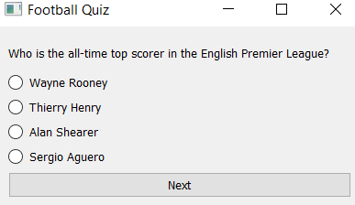
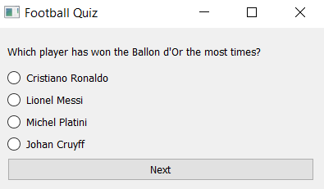
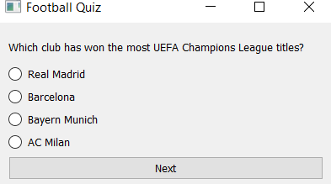
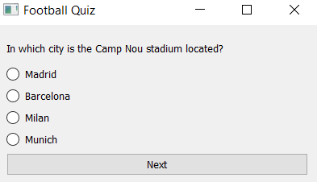
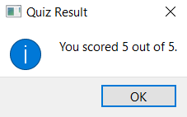
<NAME OF THE PROJECT>
IBRAHIM HASSAN
My Football Quiz gives a unique experience where you can test your football knowledge and unveil your final score in a captivating and interactive way.

Slide 5
Immerse yourself in the world of football trivia and experience my quiz today!
And for more information:
Contact me in:
0665321548 or younes15@gmail.com
<NAME OF THE PROJECT>
IBRAHIM HASSAN

